Slide 1
Assignment 4
Bonnie Yuan
Yashaswini Kotresh
Alexander Palen Ellis
Eric Feder

Slide 2
Summary on data:
Source: http://www3.norc.org/gss+website/
Datasets used: 2006(training dataset) and 2010 datasets(test dataset) from above site
Description of variables: 2008 GSS codebook
Dependent variable : income06 (model1) and ……….(model2)

Slide 3
Step1: Cleaning the data
Extracted 2006/2010 datasets in dta format
Converted into Data Frames using “statsmodels.iolib.foreign “ library
Stored the data set in CSV format in the local folder
Replaced the -999 values in the data frame (2006) with nan to count the missing values in each columns
Calculate the % of missing values in each column
Identified the cutoff for missing values in each column is 30% i.e if more than 30% data is missing in a column, drop the column ( Also cross checking if we are eliminating important columns for modeling)
Followed same process for cleaning 2010 data frame
Retaining columns which intersects both 2006 and 2010 data frames
Re-indexing columns in both data frames for next step i.e EDA

Slide 4
Step2: Understanding the variables
After intersecting 2006/2010 data frames, we obtained 99 variables
Created a correlation matrix between the variables to know which variables are very similar
In Next step, we listed all the variables in a spreadsheet along with their definition and commented whether they are continuous or categorical
Also some variables didn't make sense (intuitively), hence we dropped them from our model eg: phone/coop/comprehend etc
Identified which variables have to be factorized from categorical variables.[ Need to explain more]

Slide 5
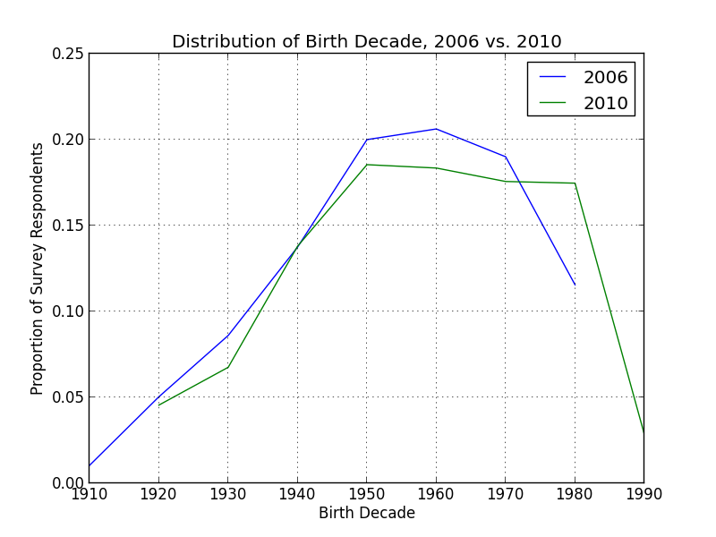
Step 3: EDA
Maximum number of respondents were born in 1950-1980 decade

Slide 6
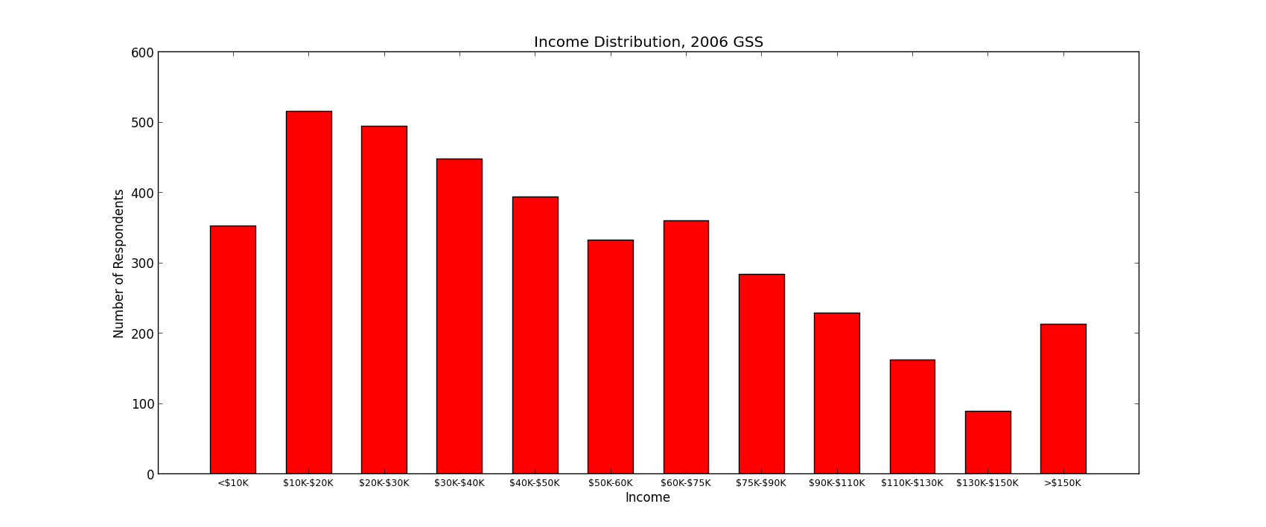
Step 3: EDA
Distribution of dependent variable income06

Slide 7
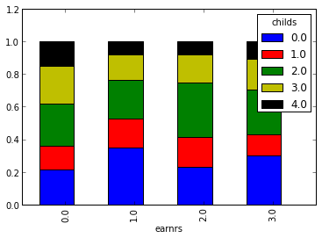
Step 3: EDA
Distribution of earners in a household with number of children
(There is not a clear trend of more earners corresponding to more children)

Slide 8
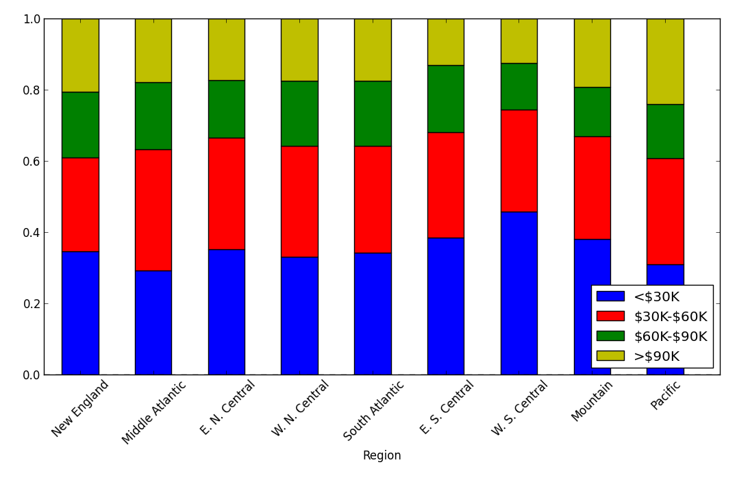
Step 3: EDA
Distribution of income brackets across region
- West S Central has highest proportion of low income households
- Pacific and East coast has highest proportion of high income households

